Slide 1
_{A?} innovaccer
EFFICIEN'T HEALTHCARE
WITH ACENATED DATA

Slide 2

THE PLATFORM WAS BORN 200+ research projects 70+ top institutes | ENTER HEALTHCARE WITH A BANG 35+ practices 200,000+ Lives | TOP DATA PLATFORM IN HEALTHCARE Recognized by Gartner, MedTech, Forbes, and 10+ organizations.
2014 2017
2019
2013 2015
2018
INCORPORATED AUG ‘14 Raised seed funding | USED AT SCALE Expanded Managed Lives to 4.5M+ | 92.8* OVERALL KLAS SCORE Rated in the recent KLAS report.
 | *Scores based on limited data | Copyright Innovaccer. All Rights Reserved.

Slide 3





 | GLENN STEELE MD Former President and Chief Executive Officer of Geisinger Health System | PHIL FASANO Former CIO Kaiser Permanente, former Executive VIce President and CIO, AIG | PAUL GRUNDY MD Former CMO of IBM, Godfather of the Patient Centered Medical Home | DEB HENRETTA Former Group President, Procter & Gamble, Senior Adviser for SSA & Company
$120M
CAPITAL RAISED
STEPHEN KLASKO | DAVID NASH MD | JONATHAN BUSH | ADRIENNE WHITE-FAINES
President of Thomas | Founding Dean Emeritus, | Founder | Former CEO of the American
Jefferson University and CEO of Jefferson Health | Grandon Professor of Health Policy, Jefferson College of | athenahealth | Osteopathic Association (AOA), former Board of Directors
 | Population Health |  | PCPCC
 | Copyright Innovaccer. All Rights Reserved.

Slide 4










 |  |  |  |  |  | Healthcare Applications
POPULATION HEALTH CARE WORKFLOWS POINT OF CARE AI PATIENT ENGAGEMENT HEALTH DATA API
InGraph InCare InNote InConnect InAPI
DATA ACTIVATION PLATFORM
Data Management, Monitoring and Security
1 Cleaning & Standardization 2 Analytics Engine (Hadoop, Spark) 3 Visualization Engine
 |  |  |  |  |  | Two-way Interoperable Data Connectors
EMRs and LABS PAYER CLAIMS DEVICE DATA PHARMACY FINANCIAL AND OTHERS
75+ 10+ 20+ 5+ 15+
 | Copyright Innovaccer. All Rights Reserved.

Slide 5

CONNECTED DATA CAN ENABLE
Holistic Patient View
Point-of-care Decision Support Outcome-based Payments Standardized Care Delivery Productive Workforce Engaged Patients

Slide 6

AGGREGATE
Bring all your data together in one place without writing a single line of code.
ANALYZE
Project where you can be to stay on track with deep analytics of your past performance.
60+
Type of data sources
150+
Formats
10M+
Records in Taxonomy Knowledge Base
500+
Healthcare IT Vendor Connectors
62
Coding Standards Quality Checked
600
Data Fields
ACTIVATE
Go the extra mile with activated data and keep your
patients closer, care teams engaged, and performance
on track.
 | Copyright Innovaccer. All Rights Reserved.

Slide 7
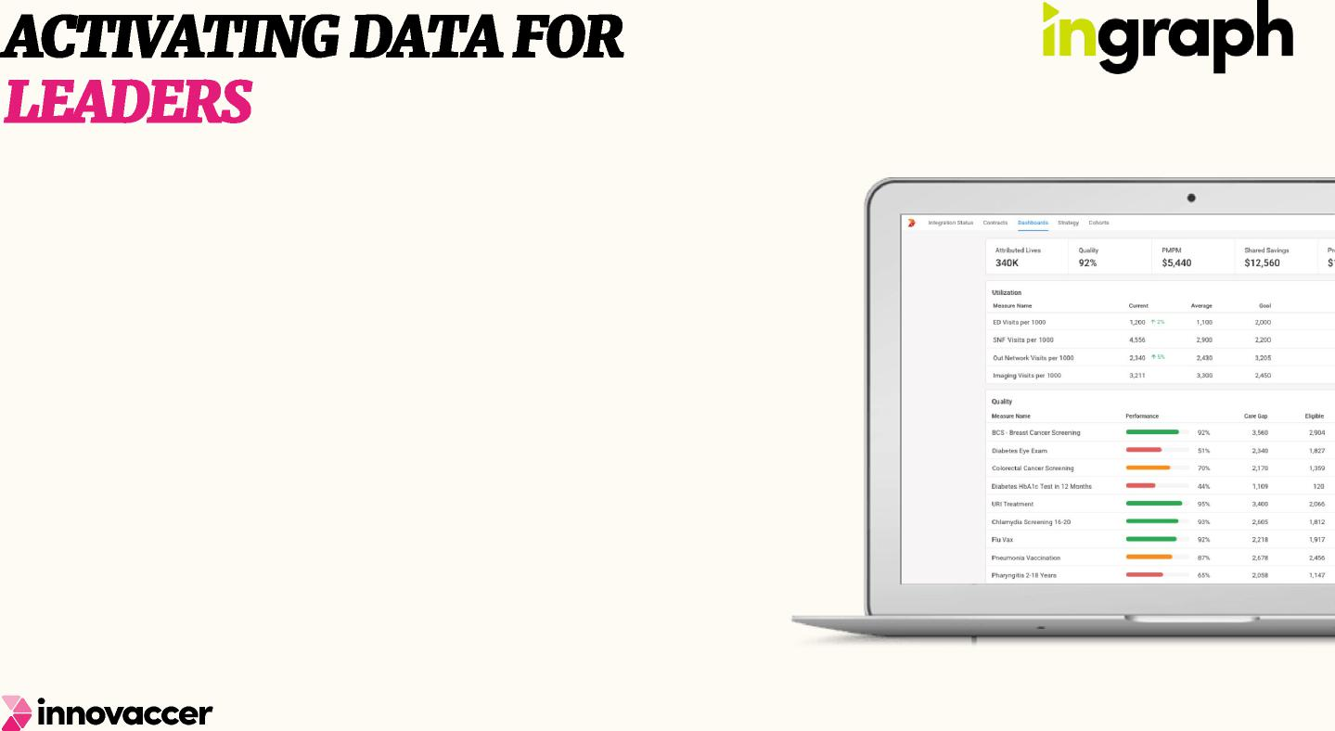
MANAGE COST AND QUALITY
Keep a close eye on your performances and the areas where you can improve
16+
Type of charts
10+
Built-in Dashboards
TAKE ACTIONS AND MEASURE IMPACT
Never wait for any report; create and customize your own, take actions, and drive better outcomes
250+
Quality, Utilization and Cost Measures
KNOW WHEN SOMETHING CHANGES
Stay on top of any new development anywhere across your network with real-time alerts
Copyright Innovaccer. All Rights Reserved.

Slide 8
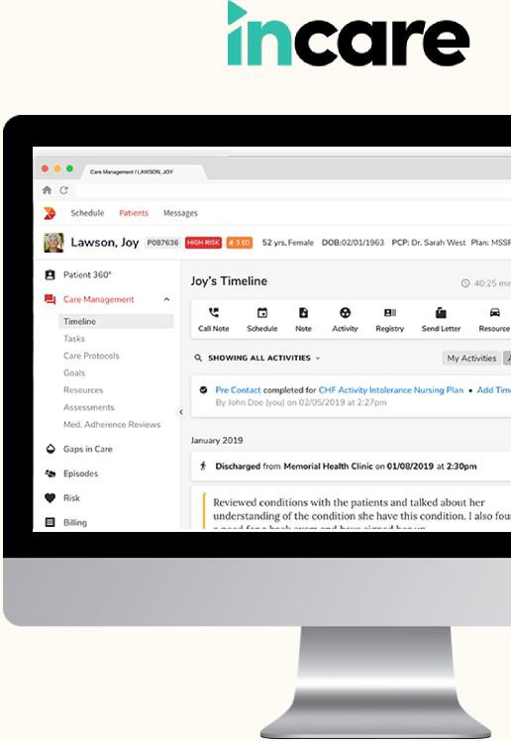

STANDARDIZE CARE DELIVERY Build a care delivery mechanism that lets you focus on what you do best – provide seamless care efficiently. Really. AUTOMATE THE REDUNDANT Empower your teams with capabilities that save their time and effort, and drive attention to the most needful. QUANTIFY YOUR TEAM’S EFFORTS See what works and what doesn’t. Know your outcomes and plan accordingly.
 | Copyright Innovaccer. All Rights Reserved.

Slide 9
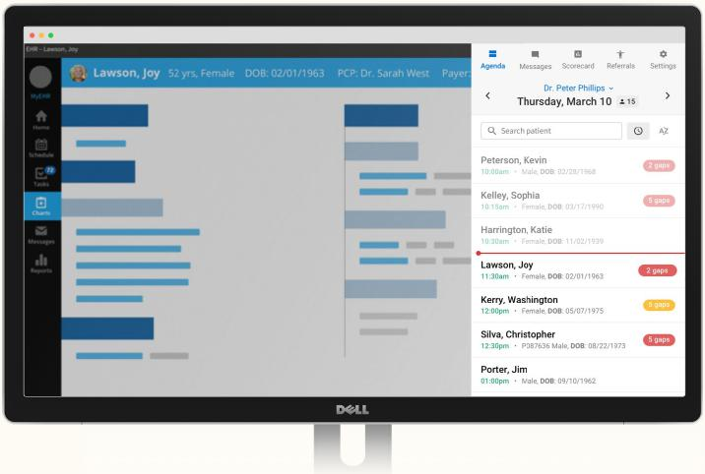
KNOW WHAT YOUR EMR ISN’T TELLING YOU Go beyond the EMRs, see your patient’s summaries, and what they need in the moment of care EXTEND CARE BEYOND THE EXAM ROOM Involve your care team in your process seamlessly and help patients in their homes MEASURE WHERE YOU STAND See yourself in the network and compare where you stand. Understand what will take your metrics up.
 | Copyright Innovaccer. All Rights Reserved.

Slide 10
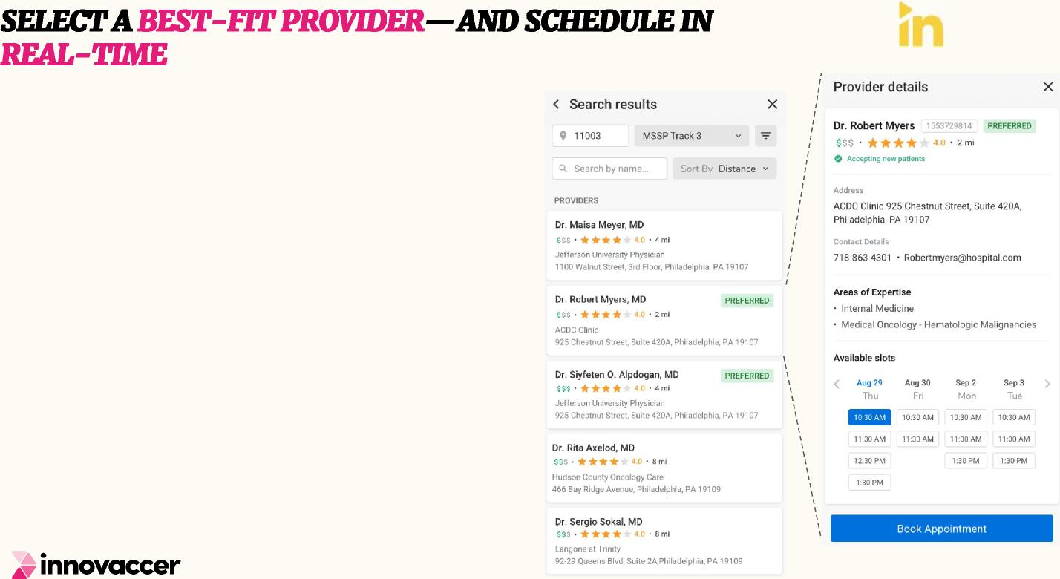
ref
HASSLE FREE REFERRALS PLACEMENT
Take advantage of pre-filled patient details, and avoid manual sending of clinical documentation for referrals by using e-fax / e-attachment instead.
CHOOSE A BEST-FIT PROVIDER
Leverage data on provider cost and quality performance, distance, and provider in-network preferred status to choose the best provider for a patient.
REAL TIME SCHEDULING OF APPOINTMENTS
Book appointments in real-time based on provider availability, leveraging direct connectivity to EMR / PMS systems.
10

Slide 11

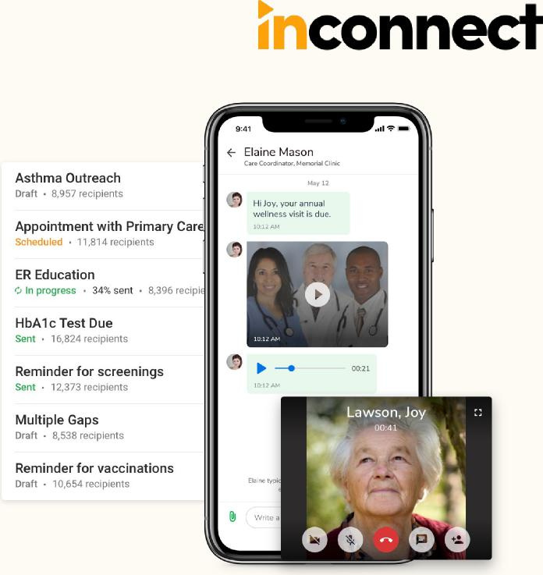
KEEP YOUR PATIENTS ENGAGED
Don’t worry about gaps in care journey of patients. Identify and reach them whenever need arises.
EMPOWER THEM TO IMPROVE THEIR HEALTH
Give power to your patients and their families by educating them on their health and community resources
BE ACCESSIBLE IN THE MOMENT OF CARE
Now stay connected with your patient even remotely with video chats and 24/7 concierge.
Copyright Innovaccer. All Rights Reserved.

Slide 12


SOLUTIONS BY MARKET

Slide 13

CONTRACT MODELING
Innovaccer’s solution will give ACO leadership an interactive insight into their forecasted shared savings by the end-of-the year.
IMPROVE QUALITY SCORES BY PROMPTLY CLOSING QUALITY GAPS
Quick glance into the Quality performance of the entire network for the ACO
leadership and take follow up actions based on the results.
REDUCE PMPM BY PROACTIVELY TAKING ACTIONS TO MODIFY PATIENT’S BEHAVIOR
Reduce ED visits
Optimize SNF/Cost Utilization
Reduce Network Leakage
EFFECTIVELY MANAGE HIGH RISK PATIENT POPULATION
ASSISTANCE IN REPORTING THEIR QUALITY PERFORMANCE TO CMS
Leverage patient stratification
Assign Patients to Care Managers
Notify Care Team
Recommend Community Resources
Send Educational Materials to Patients
Web-Interface Reporting
User Guidance
Assisting users through Evidence
Copyright Innovaccer. All Rights Reserved.

Slide 14
CLAIMS AGGREGATION AND PAYMENT PRICING
Aggregate and manage claims for as many patients with Innovaccer’s revolutionary data activation platform for payment distribution.
AUTOMATE YOUR CARE MANAGEMENT STRATEGIES
Address the unique needs of
your members to optimize
utilization and improve
margins.
CREATE PATHWAYS FOR TRANSITIONAL CARE MANAGEMENT
Manage your members inside and outside the care facility to reduce the possibility of unnecessary readmissions.
EFFECTIVELY MANAGE
ALL THE BUNDLES
ENSURE TIMELY FILING AND RECONCILIATION
Find and meet targets
Handle retrospective & prospective payments
Engage physicians at each level
Calculate episode costs
Streamline the process of referral
management
Support for timely payment reconciliation Improved accuracy of claims across multiple reimbursements and risk arrangements
 | Copyright Innovaccer. All Rights Reserved.

Slide 15
MONITOR & CLOSE GAPS IN CARE
Clearly understand the quality and gaps in care by establishing real-time clinical data exchange.
ACHIEVE 5 STAR
RATINGS
Improve care quality and STAR ratings by informing physicians of care and coding gaps at point-of-care.
OUT WITH MANUAL PROCESSES THAT TAKE FOREVER.
AUTOMATE & CUSTOMIZE ENGAGEMENT
Drive better engagement through automation and customization option to roll out tests, video messages, and others to support follow-up.
Automated chart retrieval
Point-of-care physician engagement Flexible and collaborative workflows
 | Copyright Innovaccer. All Rights Reserved.

Slide 16
CASE STUDIES

Slide 17

REDUCTION IN 30-DAY | INCREASE IN PRIMARY | REDUCTION IN ED | INCREASE IN ANNUAL
READMISSION RATES | PROVIDER SERVICES/1K | UTILIZATION / 1K | WELLNESS EXAMS
SHARED SAVINGS WENT FROM
ZERO TO $5 MILLION
IN TWO YEARS
 | Copyright Innovaccer. All Rights Reserved.

Slide 18




UNITEDHEALTHCARE | INCREASE IN | INCREASE IN | INCREASE IN
PARTICIPANTS | COLORECTAL CANCER | BREAST CANCER | CERVICAL CANCER
 | SCREENING | SCREENING | SCREENING
REDUCED HEALTH CARE SPEND BY
MORE THAN $28 MILLION
FOR OVER 78,000 UNITEDHEALTHCARE
PLAN PARTICIPANTS
 | Copyright Innovaccer. All Rights Reserved.

Slide 19




MEMBERS | REDUCTION IN ED | INCREASE IN | COST SAVING
 | UTILIZATION | BENCHMARKS | OPPORTUNITY
 |  | WITH CDI | CAPTURED
11% OF CARE GAPS PLUGGED TO
Customer Video IMPROVE THE STAR RATINGS BY 0.5
WITHIN THE FIRST 3 MONTHS
 | Copyright Innovaccer. All Rights Reserved.

Slide 20


ΔΕΜΟ

Slide 21
ΤΗΑΝΚ ΨΟΥ

Slide 22
ΑΠΠΕΝΔΙΞ

Slide 23

UNLOCK THE DATA SURFACE INSIGHTS DELIVER THEM WITHIN THE
EXISTING WORKFLOW AT ALL POINTS OF CARE

Slide 24
Lack of clear visibility into cost and utilization structures
Unpredictability in shared savings at the end of the year
Manual review of the patient charts while reporting
Lack of access to latest patient attribution list
Reliability on analysts to identify and prioritize patients with care gaps
Absence of an accurate and comprehensive longitudinal patient record
Lack of insight into patients who could fall off the attribution list
Lot of manual and time-consuming repetitive work for Care Coordinators
 | Copyright Innovaccer. All Rights Reserved.

Slide 25
Choosing Bundles
Negotiating with payers
Identifying patients that will quality for a bundle
Monitoring and tracking progress of patients
Reducing the error margins due to manual process
Managing patients going out of network during 90-day period
Ensuring care team performance despite unavailability of bundle specific-standardized guidelines/ pathwa
 | Copyright Innovaccer. All Rights Reserved.

Slide 26
Dependent on the Providers to close the gaps which will eventually help them improve the Star Ratings
Communication barriers with the Providers on the care gap closure causing delays
Lot of manual work involved to close the Care Gaps & Coding Gaps which is time consuming
 | Copyright Innovaccer. All Rights Reserved.

Slide 27
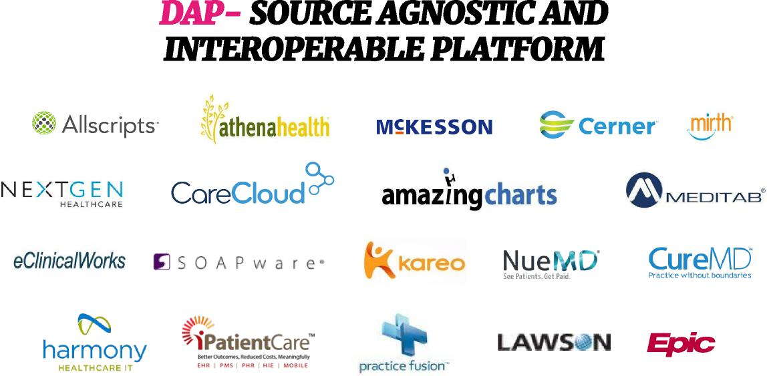

InData has pre-built connectors to 100+ data sources, which reduces time to market, reduces adoption friction, and drives low-cost integration of new data sources, ensuring future scalability

